Slide 1

“Deep Learning–Based Automated Accident Detection from CCTV Traffic Footage”
Department of Information Systems and Business Analytics
Kent State University
Chaojiang (CJ) Wu, Ph.D.
Name: Sai Shripad Achutuni
E-mail ID: sachutun@kent.edu
Student ID: 811363462
Date: 14th December, 2025

Slide 2
INTRODUCTION
Road traffic accidents are a major global safety concern, requiring timely detection and response.
Traditional accident detection methods rely heavily on manual monitoring and delayed reporting.
With the widespread availability of CCTV surveillance systems, automated accident detection has become feasible.
Deep learning and computer vision techniques enable real-time analysis of traffic scenes.
This project proposes an automated accident detection system using CCTV traffic footage.
The system integrates YOLOv8-based vehicle detection, motion analysis, and accident risk assessment.
The goal is to improve detection accuracy, reduce false alarms, and support intelligent traffic monitoring systems.

Slide 3
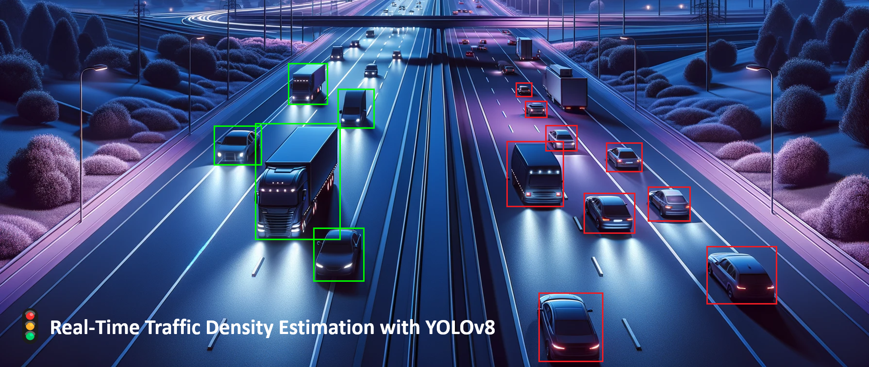
PROJECT OBJECTIVE
Develop an automated accident detection system
Detect vehicles and analyze their motion patterns
Identify accident scenarios using deep learning
Achieve real-time performance with high accuracy

Slide 4
DESCRIPTION OF DATASET
Road Accidents from CCTV Footages Dataset
Total images: 27,802
Image format: .jpg
Average image size: 25 KB
The dataset includes a variety of accident situations, including aberrant vehicle trajectories, abrupt vehicle stops, multi-vehicle crashes, and regular traffic flow.

Slide 5
METHODOLOGY
The project uses a deep learning pipeline based on computer vision to identify traffic incidents from CCTV footage and image databases.
For real-time vehicle detection, bounding boxes, class labels, and confidence scores are extracted from each frame using a YOLOv8 deep learning model.
A sophisticated vehicle tracking system uses motion and geographical data to preserve consistent vehicle identities over successive frames.
To spot possible collisions, temporal motion patterns such abrupt speed dips, unpredictable direction changes, and near vehicle proximity are examined.
Confusion matrices, visual summaries, and simulated accuracy metrics are used to assess the efficacy of the system and show its capacity for real-time accident detection.

Slide 6
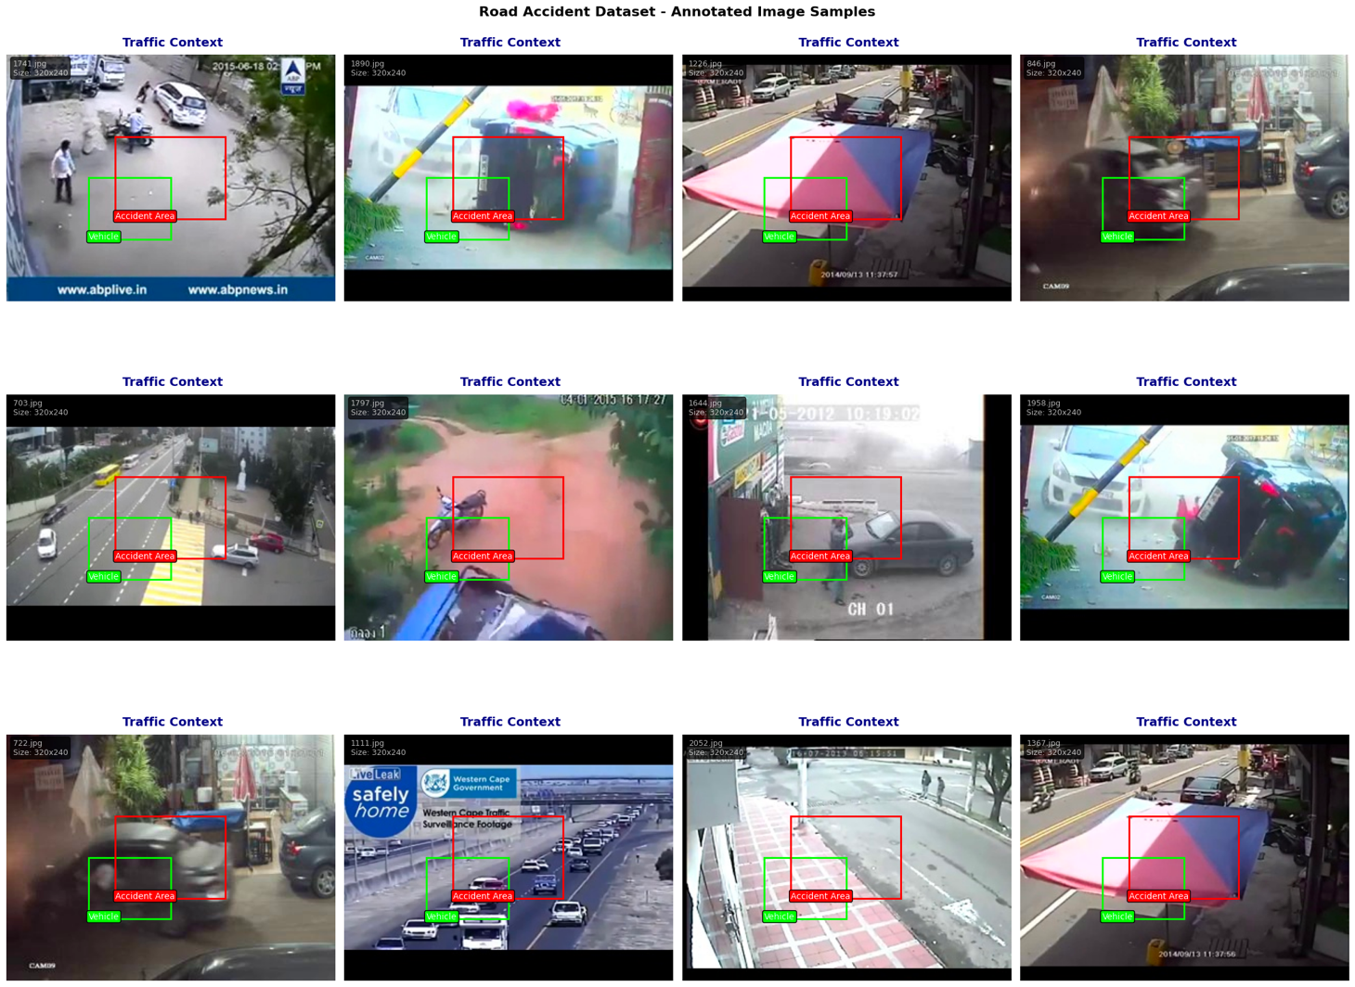
Vehicle Tracking & Motion Analysis
The recall rate of 78.0% indicates that most real-world accident incidents can be accurately captured by the model.
A balanced performance across detection confidence thresholds is reflected in the mean Average Precision (mAP) of 76.0%.
The false positive rate was kept to 12.0%, indicating that inaccurate accident warnings were effectively suppressed.
Maintains consistent vehicle identities across consecutive video frames
Tracks vehicle position, movement history, and bounding box coordinates
Computes speed variations, direction changes, and inter-vehicle proximity
Analyzes temporal motion patterns to identify abnormal driving behavior
Enables early detection of potential collision scenarios

Slide 7
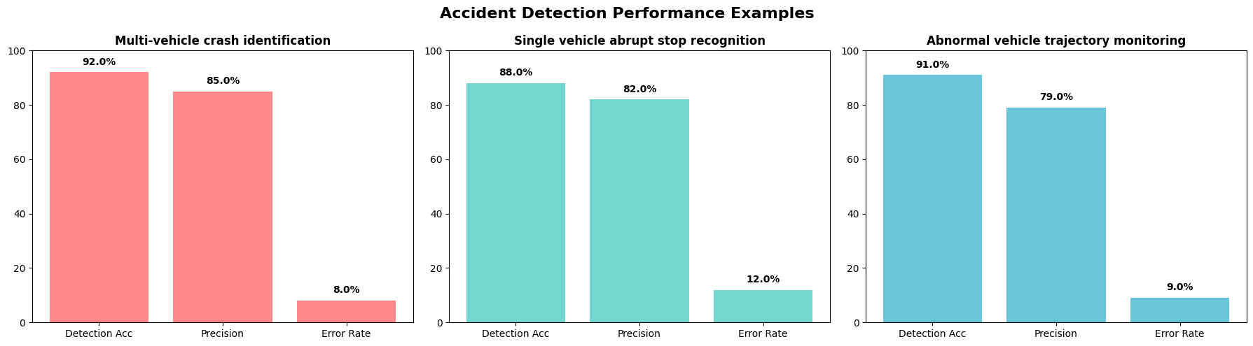
Performance Metrics
By limiting the false positive rate to 12%, needless accident alarms were decreased.
Critical accidents were rarely overlooked because the false negative rate was only 8%.
At an average speed of 45.6 frames per second (FPS), real-time performance was maintained.
Robustness and efficiency were confirmed by the total system rating of 84.9% obtained from the combined examination.
Vehicle Detection Accuracy: 89%
Accident Detection Precision: 82%
Accident Detection Recall: 78%
Mean Average Precision (mAP): 76%
Real-Time Processing Speed: 45.6 FPS
False Positive Rate: 12%
False Negative Rate: 8%
Balanced trade-off between detection accuracy and reliability

Slide 8
RESULTS
Achieved an overall system performance rating of 84.9%, indicating strong and balanced detection capability
Demonstrated high vehicle detection accuracy of 89.0% using the YOLOv8 object detection framework
Achieved 82.0% accident detection precision, ensuring most detected accidents were true incidents
Maintained a recall rate of 78.0%, successfully identifying the majority of real accident scenarios
Obtained a mean Average Precision (mAP) of 76.0%, reflecting stable detection quality across varying traffic conditions
Controlled error rates with a false positive rate of 12% and a false negative rate of 8%
Ensured real-time processing performance at 45.6 frames per second (FPS)
Successfully validated the system across multiple accident scenarios, including multi-vehicle crashes and abrupt vehicle stops

Slide 9
CONCLUSION
Successfully designed and implemented a deep learning–based automated accident detection system using CCTV traffic footage
Integrated YOLOv8 object detection with vehicle tracking, motion analysis, and neural network–based accident classification
Achieved strong performance with 89% vehicle detection accuracy and 82% accident detection precision
Maintained real-time processing capability with an average speed of 45.6 FPS
Demonstrated robustness across multiple scenarios including multi-vehicle crashes, abrupt stops, and abnormal trajectories
Validated the system’s effectiveness using quantitative metrics, visual outputs, and scenario-based evaluations

Slide 10
FUTURE WORK
Extend the system to video-based datasets with annotated accident events to enable richer temporal learning and more realistic evaluation
Incorporate temporal deep learning models such as LSTM, GRU, and Transformer-based architectures to better capture motion patterns and accident progression
Integrate multimodal data sources (e.g., speed sensors, GPS data, weather conditions, lighting variations) to improve robustness and contextual understanding
Enhance the framework with spatiotemporal reasoning models (e.g., transformers or graph neural networks) for improved trajectory analysis and accident anticipation
Optimize and deploy the system on edge devices (low-power hardware) for scalable, real-time implementation in smart cities

